Slide 1

AN EASY WAY TO UNDERSTAND DATA
SUPPLEMENTARY MATERIAL
Null Hypothesis: A=B
Second Hypothesis: A<>B

Slide 2
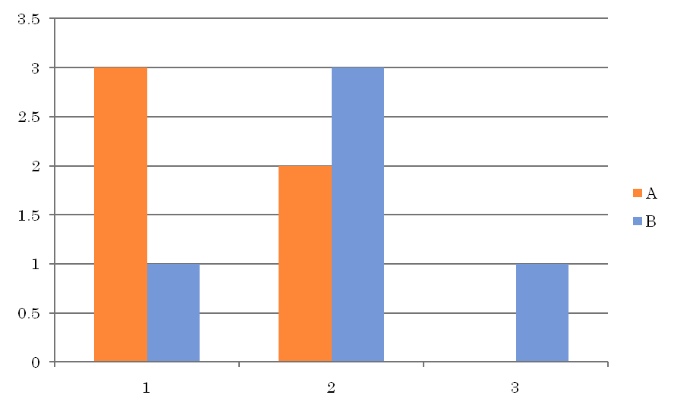
DATA
Do you think we should reject the null hypothesis

Slide 3
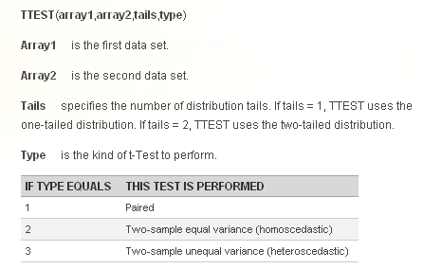
MICROSOFT EXCEL T-TEST
A one-tailed test uses an alternate hypothesis that states either H1: μ > μ0 OR H1: μ < μ0, but not both. If you want to test both, using the alternate hypothesis H1: μ ≠ μ0, then you need to use a two-tailed test.

Slide 4
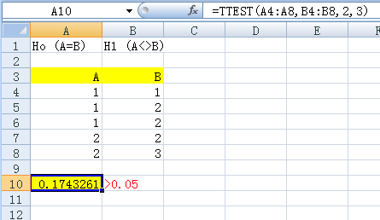
0.05 MEANS 5%

